Slide 1

New Summarization Application
Group 10

Slide 2



Members
Chathurika R.E: IT22315250
Mihara B.D.B: IT22345400
Gunawaradena T.P: IT22358066
Samanmalee A.H.M.C.M: IT22640048

Slide 3

Objective
Summarizing large volumes of text data
Analyzing sentiment
Identifying underlying topics

Slide 4
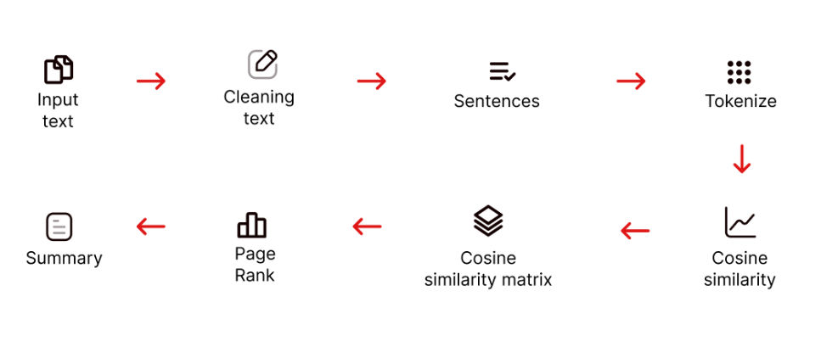
News Summarization
Alternative Solution
Jaccard Similarity
Euclidean Distance
BERT
Latent Semantic Analysis (LSA)

Slide 5

Sentiment Analysis
Sentiment analysis identifies the emotional tone in news articles, classifying it as positive, negative, or neutral.
Sentiment analysis identifies the emotional tone in news articles, classifying it as positive, negative, or neutral
This analysis enhances the clarity of news summaries by revealing the emotional context, making the content more engaging and insightful.

Slide 6

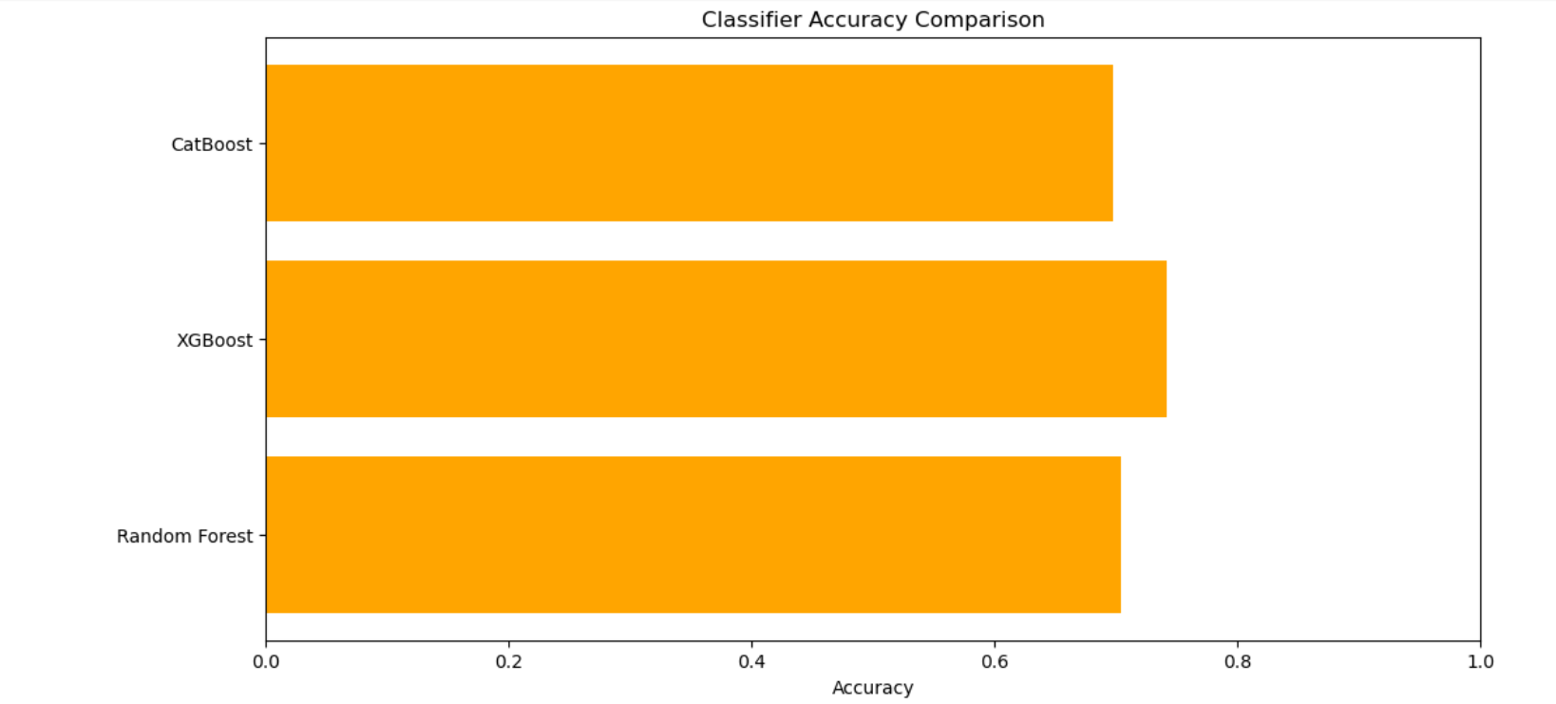
Model Implementation
Three models were built :
XGBoost
CatBoost
Random Forest Classifier
Out of these models, the model with the highest accuracy and other evaluation metrics was chosen and implemented

Slide 7
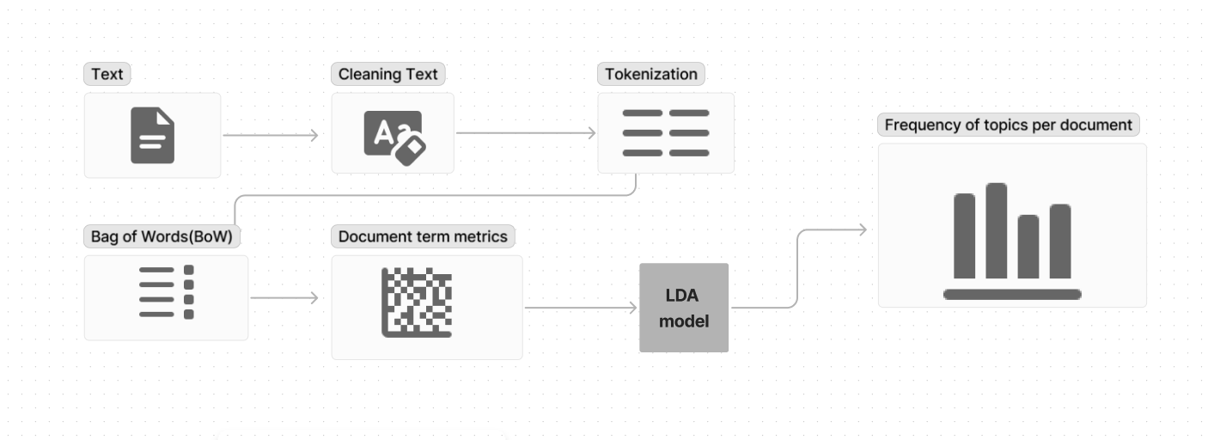
Topic Modeling
Topic modeling is a statistical technique used in natural language processing (NLP) to discover abstract "topics" within a collection of documents

Slide 8


Challenges Faced and Solutions
Data Preprocessing and Cleaning
Handling missing values and removing irrelevant
columns from the dataset required careful attention to ensure that essential data was
retained.
News Summarization
Implementing cosine similarity for text summarization posed challenges in determining the appropriate threshold for sentence similarity.
Model Selection and Evaluation
Choosing the most suitable machine learning model
for sentiment analysis was challenging, as multiple models (XGBoost, CatBoost, Random Forest) were tested.

Slide 9

Suggestions for future enhancement
Get the summarization in multiple languages
Generate the output result in any language the user desires
Make input so not only text can be entered but also images and text as well
Make the output in a voice format as well so that people with disability such as blindness
can also use the application

Slide 10
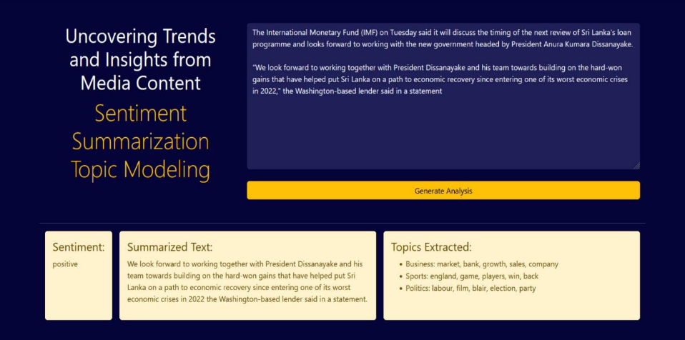
Application frontend

